Slide 1


Gaming Sentiment Analytics Architecture

Slide 2
Ingesting any data sources

Slide 3








High Level Architecture
OCI AI Services
Twitter Agent
Index / Categorization
Twitch Agent
Instagram Agent
Sentiment
Analysis
OAC Instance
ML/AI
CONNECTIONS:
ADMIN
TWITCH
TWITTER
…
TikTok Agent
SCHEMAS:
TWITCH
TWITTER
INSTAGRAM
…
Facebook Agent
…
…
SOCIAL_AGENTS
SENTIMENT_ATP
DASHBOARD

Slide 4
Gaming Sentiment Analysis Service Understanding

Slide 5
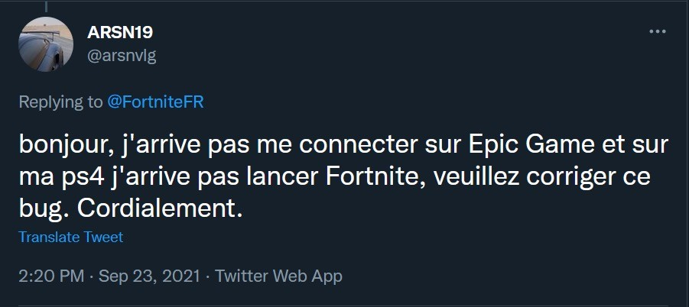
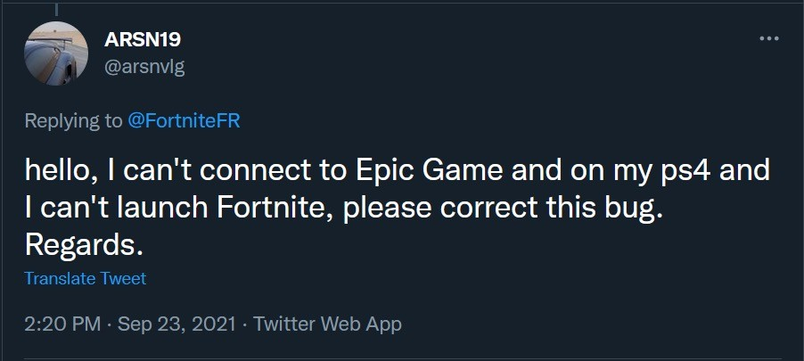
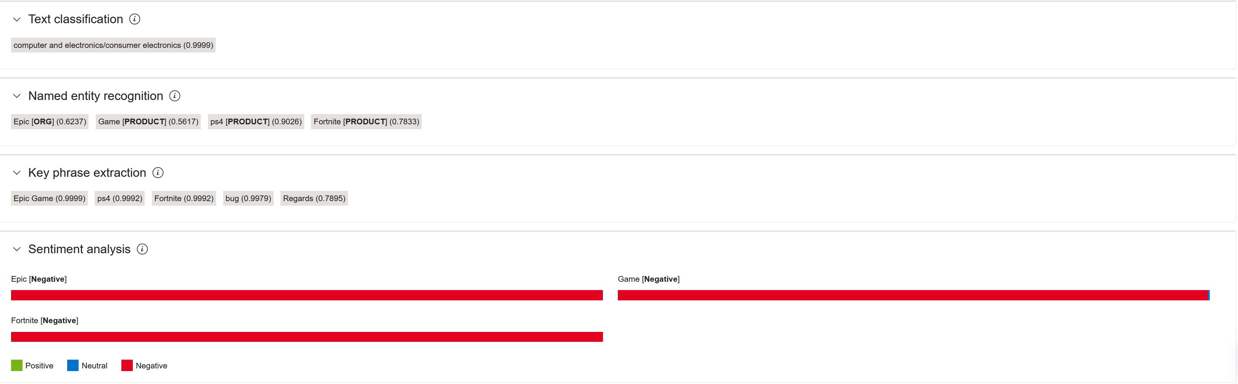
Tweet Example

Slide 6
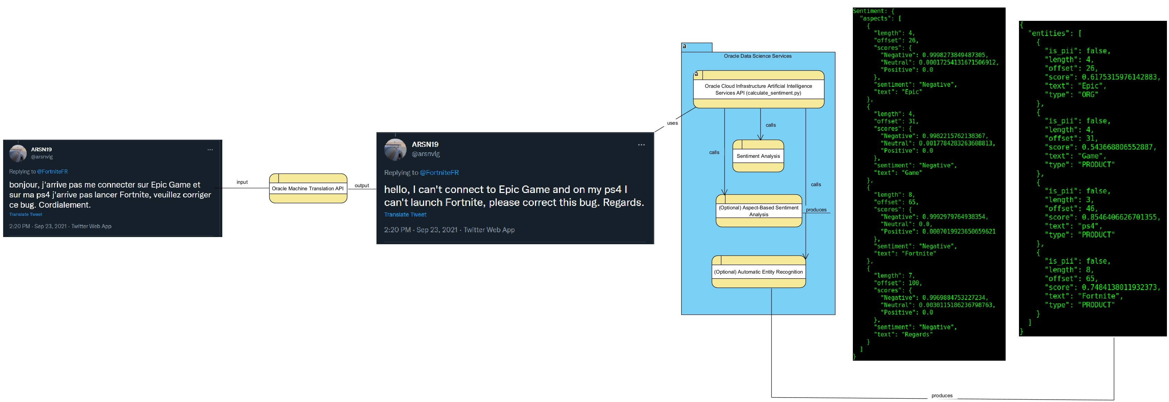
Sentiment Analysis Pipeline
Automatic Named Entity Recognition + ABSA
Automatic Tweet Translation (Oracle MT API)

Slide 7



Sentiment & Bias Training Process
Training
Conversations
Document
Export
Understanding
Tokens
Sentences
Named Entities
Tokenizer
Sentences
NER
Relations
Sentiment
Analysis
feature
feature
Feature
Feature selection
Model
Training

Slide 8
Sentiment & Bias Execution Process
Execution
Conversations
Document
Export
Understanding
Tokens
Sentences
Named Entities
Tokenizer
Sentences
Chunker
Sentiment
Analysis
Model
Conversations
NLG
Data-Driven
Rule-based
BNF (Macro-language)

Slide 9


